Slide 1



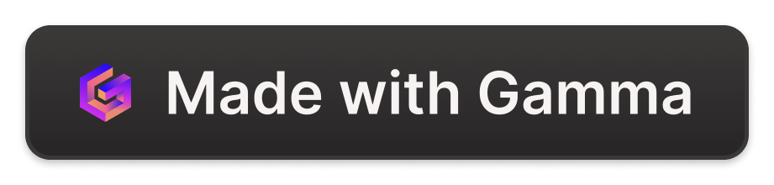
Introduction to the 7 R's of Cloud Migration
Navigating the cloud migration journey can be daunting, but the 7 R's framework provides a roadmap for a successful transition. This presentation will explore the key strategies, from rehosting to replacing, to help organizations maximize the benefits of the cloud.
by Abdelilah Choukri

Slide 2

Rehost: Lift and Shift
1
Simplest Approach
2
Immediate Benefits
3
Potential Limitations
Rehosting involves migrating applications to the cloud without making any changes to the underlying architecture.
This method can quickly provide cost savings and scalability, allowing organizations to leverage cloud infrastructure.
Rehosting may not fully unlock the cloud's capabilities, and some optimization opportunities may be missed.

Slide 3
Replatform: Optimize without Changing Core
Enhance without Rearchitecting
Gradual Improvements
Balanced Approach
This approach allows organizations to optimize their applications incrementally, without the need for a full-scale rearchitecture.
Replatforming strikes a balance between the simplicity of rehosting and the complexity of refactoring, making it a popular choice for many organizations.
Replatforming involves making minor changes to an application to take advantage of cloud-native features, such as managed databases or serverless functions.

Slide 4

Refactor: Rearchitect Application
1
Identify Pain Points
Analyze the existing application to pinpoint areas that can be optimized or modernized.
2
Redesign Architecture
Rearchitect the application to leverage cloud-native services and best practices, such as microservices and serverless.
3
Implement Changes
Gradually implement the new architecture, ensuring a smooth transition and minimal disruption to the application's functionality.

Slide 5
Retire: Decommission Unused Assets
Identify Unused Assets
Decommission Securely
Thoroughly analyze the existing IT infrastructure to identify applications, servers, and other assets that are no longer in use.
Ensure that all data and sensitive information is properly handled and disposed of during the decommissioning process.
Realize Cost Savings
Optimize Infrastructure
Retiring unused assets can lead to significant cost savings, as organizations no longer need to maintain or support these resources.
By removing unnecessary assets, organizations can streamline their IT infrastructure and focus resources on more critical applications.

Slide 6




Re-architect: Redesign Application
Analyze Current State
Thoroughly evaluate the existing application, including its architecture, infrastructure, and performance.
Identify Opportunities
Determine areas where the application can be modernized, optimized, or re-architected to take advantage of cloud capabilities.
Redesign and Implement
Develop a new, cloud-native architecture and gradually implement the necessary changes to the application.

Slide 7




Replace: Substitute with SaaS or PaaS
SaaS
PaaS
Database Services
Analytics and AI
Substitute on-premises applications with Software-as-a-Service (SaaS) solutions, which can offer more scalable and cost-effective options.
Replace custom-built applications with Platform-as-a-Service (PaaS) offerings, which provide pre-built infrastructure and services to accelerate development.
Adopt cloud-based analytics and artificial intelligence services to unlock new insights and capabilities.
Leverage managed database services in the cloud, which can simplify maintenance and scaling tasks.

Slide 8
Retain: Keep On-Premises
Regulatory Compliance
Some industries or applications may have strict compliance requirements that necessitate keeping certain assets on-premises.
Latency-sensitive Applications
Applications that require ultra-low latency, such as real-time trading systems, may perform better in an on-premises environment.
Legacy Systems
Older, legacy applications may be difficult or costly to migrate to the cloud, making it more practical to retain them on-premises.
Customized Infrastructure
Organizations with highly specialized or customized IT infrastructure may find it challenging to replicate the same level of control and performance in the cloud.

